Slide 1
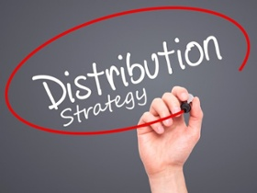
Lecture 11
Determine the Distribution Strategy

Slide 2
Types of Distribution Channels and Wholesale Intermediaries
Physical distribution refers to activities that move finished goods from manufacturers to final customers.
A channel of distribution is a series of firms or individuals that facilitates the movement of a product to a final consumer.
Direct channels
Indirect channels

Slide 3
Distribution Channel Functions
Breaking bulk: Purchase large quantities of goods from producers but sell only one or a few at a time to many different customers.
Creating assortments: Provide variety of products in one location, so customers can conveniently buy many different items from one seller.
Transportation and storage: Occurs when retailers and other channel members move the goods from the production point to other locations where they can hold them until consumers want them

Slide 4
Distribution Channel Functions
Facilitating functions: Make the purchase process easier for customers and manufacturers (e.g., offering credit to buyers)
Risk taking: Chance retailers take on the loss of a product when they buy a product from a manufacturer because the product sits on the shelf because no customers want it
Communication and transaction: When channel members develop and execute both promotional and other types of communication among members of the channel

Slide 5
Online Distribution
The Internet has changed how channel members coordinate supply chains.
Knowledge management
Use of the Internet as a distribution channel not without challenges
Online distribution piracy

Slide 6
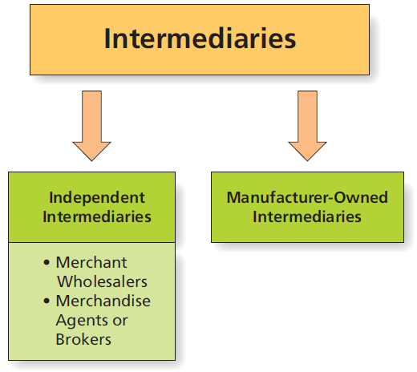
Key Types of Intermediaries
Notes:
Channels of distribution contain both wholesalers and retailers. Wholesaling intermediaries are firms that handle the flow of products from the manufacturer to the retailer/business user.
Various forms exist:
Independent intermediaries do business with many different manufacturers and many different customer firms and thus help the flow of goods throughout the marketplace.
Merchant wholesalers are independent intermediaries that buy goods from manufacturers and sell to retailers and other B2B organizations. Because they take title to goods (meaning they take legal ownership of the items), they assume risk and can suffer financial losses if the products are damaged while in their possession, or if they become obsolete or just don’t sell. There are several forms of merchant wholesalers as shown in the next slide.
Merchandise agents or brokers are independent intermediaries that provide service in exchange for commissions but never take title to the product. Sometimes they don’t even take physical possession of the product. Agents normally represent buyers or sellers on an ongoing basis whereas brokers are normally employed by clients for only a short period of time.
Manufacturer-owned intermediaries are separate business units that perform all the functions of independent intermediaries while still maintaining complete control over the channel.

Slide 7
Merchant Wholesalers
Full-service merchant wholesalers
Limited-service merchant wholesalers
Cash-and-carry wholesalers
Truck jobbers
Drop shippers
Mail-order wholesalers
Rack jobbers
Notes:
Full-service merchant wholesalers provide delivery, credit, repairs, advertising market research and more to their customers, and often field their own sales force. General merchandise wholesalers (such as a food wholesaler) carry a wide variety of different items, whereas specialty wholesalers (such as a candy wholesaler) carry a deep assortment of items within a specific product line.
By contrast, limited-service merchant wholesalers provide fewer services to their customers, and include the cash-and-carry wholesaler, truck jobbers, drop shippers, mail-order wholesalers, and rack jobbers, each of which is described below.
Cash-and-carry wholesalers provide products for small-business customers and are used to distribute low-cost merchandise for small retailers and other business customers.
Truck jobbers deliver perishable food and tobacco items to retailers (e.g., those that deliver bread to stores)
Drop shippers take orders from retailers and bill retailers for bulky items that are drop shipped from the manufacturer
Mail-order wholesalers sell through the phone, via mail order, or catalogs and thus provide reasonably priced items to smaller organizational customers (e.g., Granger, Harbor Tools)
Rack jobbers provide display units to retailers, check inventories, and stock shelves.
Limited-service wholesalers also take title to the merchandise, but are less likely to offer delivery, credit, or marketing assistance.

Slide 8
Merchandise Agents and Brokers
Agents and brokers provide paid services but never take title to the product.
Manufacturer’s agents
Selling agents
Commission agents
Merchandise brokers
Notes:
Merchandise agents or brokers are channel intermediaries that provide service in exchange for commissions but never take title to the product. Sometimes they don’t even take physical possession of the product. Agents normally represent buyers or sellers on an ongoing basis whereas brokers are normally employed by clients for only a short period of time.
The various forms of merchandise agents and brokers are listed and explained below.
Manufacturers’ agents use independent salespeople to promote several lines of noncompeting products.
Selling agents, particularly import/export agents market a whole product line or one manufacturer’s entire output. Their value rests in the fact that they are capable of providing all marketing functions for small manufacturers.
Commission merchants, as the name suggests, sell products on a commission basis and are best used in agricultural markets.
Merchandise brokers do not take physical possession of the good, but rather identify buyers and sellers and get them together, creating efficiencies in marketers in which many small buyers and sellers exist. (e.g., wineries and wine distributors)

Slide 9
Manufacturer-Owned Intermediaries
Producers may set up their own channel intermediaries.
Perform functions of independent intermediaries while maintaining control:
Sales branches
Sales offices
Manufacturer’s showrooms
Notes:
Sales branches are manufacturer-owned facilities that, like independent wholesalers, carry inventory and provide sales and service to customers in a specific geographic area.
Sales offices are manufacturer-owned facilities that, like agents, do not carry inventory but provide selling functions for the manufacturer in a specific geographic area. Allow members of the sales force to locate close to customers, reducing selling costs and offering better customer service.
Manufacturers’ showrooms are manufacturer-owned or leased facilities in which products are permanently displayed for customers to visit. Retailers can visit either during a trade show or all year long to see the manufacturer’s merchandise and make B2B purchases.

Slide 10
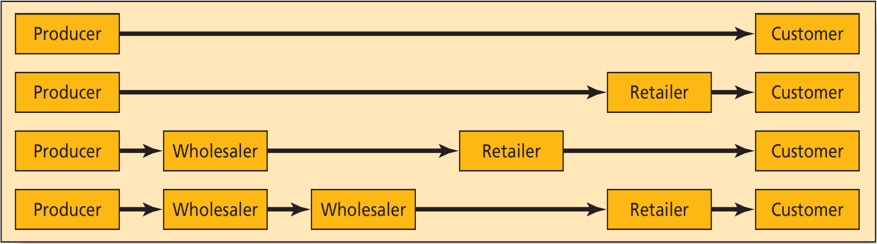
Different Types of Channels of Distribution
Major Types of Channels of Distribution
Channels differ by the number of members who participate
Choice influenced by market size, purchase frequency and intermediary availability

Slide 11
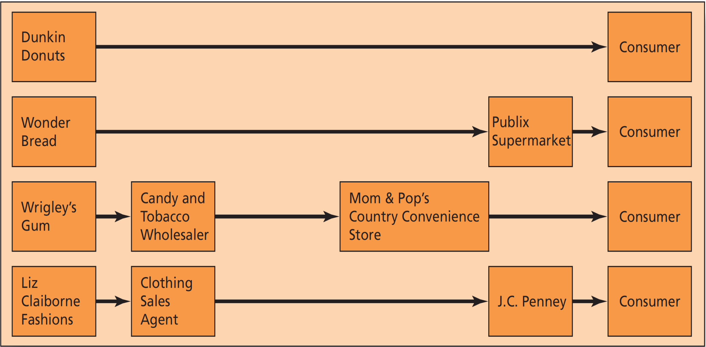
Different Types of Channels of Distribution
Typical Consumer Channels

Slide 12
Dual (Hybrid) Distribution Channels
Channel members may participate in more than one type of channel—a concept known as dual or hybrid distribution channels
Pharmaceutical companies
Some companies combine channels—direct sales, distributors, retail sales, and direct mail—to create a hybrid marketing system
Xerox
Notes:
In a horizontal marketing system, two or more firms at the same channel level agree to work together to get their product to the customer. Sometimes, unrelated businesses forge these agreements.
Most airlines today are members of a horizontal alliance that allows them to cooperate when they provide passenger air service. For example, American Airlines is a member of the OneWorld alliance, which also includes Air Berlin, British Airways, Cathay Pacific, Finnair, Iberia, Japan Airlines, LAN, Malaysia Airlines, Qantas, Qatar Airways, Royal Jordanian, S7 Airlines, SriLankan Airlines, TAM Airlines and, recently added, US Airways.
These alliances increase passenger volume for all airlines because travel agents who book passengers on one of the airline’s flights will be more likely to book a connecting flight on the other airline. To increase customer benefits, they also share frequent-flyer programs and airport clubs.

Slide 13
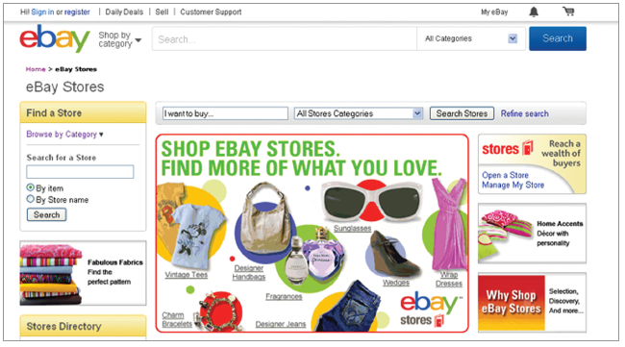
Distribution Channels and the Marketing Mix
Channel decisions impact other elements of the marketing mix.
Pricing objectives and strategies will vary based on channel member selection.
Physical features and complexity of product have channel implications.

Slide 14
Ethics in the Distribution Channel
Channel decisions can create ethical dilemmas
Slotting allowances are fees paid by producers to large retailers for access to premium shelf space.
Product diversion is the distribution of a product through one or more channels not authorized for use by the manufacturer of the product.
Selection of large intermediaries like Wal-Mart can have detrimental effects on smaller retailers.

Slide 15
Channels of Distribution
Channels facilitate movement of goods and services from producer to end consumer.
May be direct or indirect channels
Channel intermediaries vary in terms of ownership, functions performed, and whether or not they take title to products.
What do you think about the practice of slotting fees? Is this practice unethical? Unfair?

Slide 16
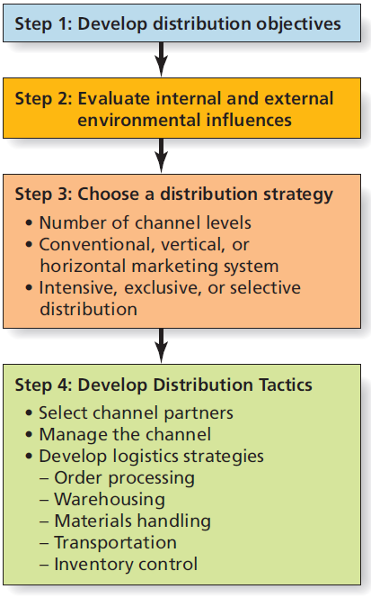
Steps in Distribution Planning

Slide 17
Step 1: Develop Distribution Objectives
Objectives must support overall marketing goals.
How does distribution work with the other marketing mix elements to increase sales, profits, or market share?
Specific objectives may depend on nature of the product (e.g., if product is heavy, a key goal may be to minimize shipping costs).

Slide 18
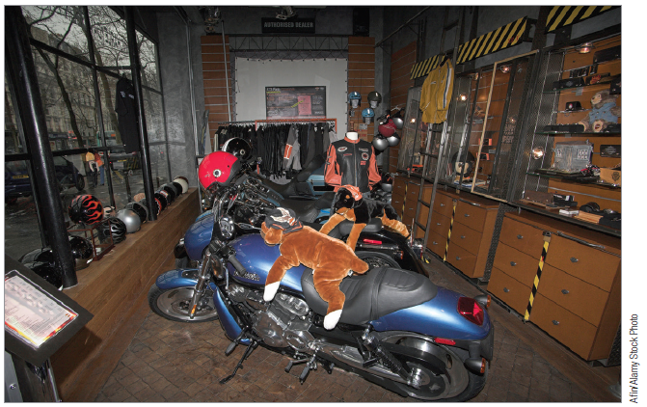
Step 2: Evaluate Internal and External Environmental Influences
What are relevant internal and external environmental influences?
How can these factors be used or minimized in developing the best channel structure?

Slide 19
Step 3: Choose a Distribution Strategy
Choice of distribution strategy involves several decisions:
Number of levels
Conventional system vs. highly integrated system
Distribution intensity

Slide 20
Intensive, Exclusive, or Selective Distribution
How many wholesalers and retailers should carry the product within a given market?
Intensive distribution: Maximize coverage by selling through as many outlets as possible.
Exclusive distribution: Limit distribution to a single outlet in a particular region.
Selective distribution: Seeks to strike a balance between intensive and exclusive distribution.

Slide 21
Step 4: Develop Distribution Tactics
Distribution tactics relate to two aspects of strategy implementation:
Selecting channel partners
Firms consider economic, competitive, relationship, and sustainability factors.
Managing the channel

Slide 22
Ethical/Sustainable Decisions in the Real World
Chipotle has been at the forefront of responsible food sourcing and handling for years.
In 2015, the chain was hit hard with foodborne illness outbreaks.
Chipotle now requires suppliers to use “DNA-based tests” on shipments to ensure they are free from E. coli.
If a restaurant knows that an upstream supplier has had problems in the past related to the improper production or handling of ingredients (even if it did not necessarily affect this particular restaurant chain), should the restaurant continue to work with that supplier?

